Slide 1

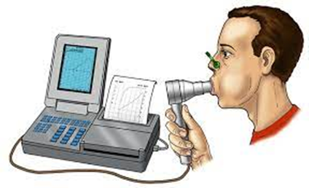
Spirometry
Spirometry is a test used to evaluate lung function. It measures how much air moves in and out of your child's lungs and how quickly this happens. It is used to diagnose respiratory diseases.
When to perform spirometry?
It is recommended to perform spirometry if your child:
Coughs very frequently
Complains of shortness of breath when running, playing, climbing stairs or walking quickly
Complains of chest pain
Has undergone therapy for respiratory problems frequently
How to perform spirometry?
Spirometry is a non-invasive test and can be easily performed in less than 10 minutes.
Before starting the test, it is important to measure your child's height because the size of their lungs is related to their height.
Your child will be asked to wear a nose clip to prevent air from passing through their nostrils and to breathe calmly through a disposable mouthpiece that is attached to the spirometer. Then, following the doctor's instructions, he or she will:
Breathe deeply with their lips closed around the mouthpiece
Blow into the mouthpiece as hard as possible
Keep blowing until the lungs are empty of air and the doctor tells you to stop.
Your child will need to repeat this maneuver at least three times, but usually no more than eight times.
It is common for children to become tired or frustrated during the test. Sometimes it takes several attempts before they can complete the test.
It is important to make sure your child understands that it is okay to rest between attempts.
Spirometry may be repeated after your child inhales a medication. This test is called a bronchodilation test.
What is a bronchodilation test?
A bronchodilator is a medication that dilates the airways. After completing the first part of the spirometry test, your child will need to inhale a bronchodilator (Salbutamol) and repeat the spirometry test about 15 minutes after taking it. The results of the second part of the test will be compared to the first to see if the medication has improved your child's breathing and to what extent this has happened.
What medications should not be given before the test?
Short-acting bronchodilators such as Salbutamol or the combination of Salbutamol and Ipratropium should not be administered for at least 4 hours before the test. In addition, a long-acting bronchodilator, such as Salmeterol or Formoterol, or combinations containing one of these bronchodilators in association with a steroid, should be stopped 12-24 hours before the test.

Slide 2
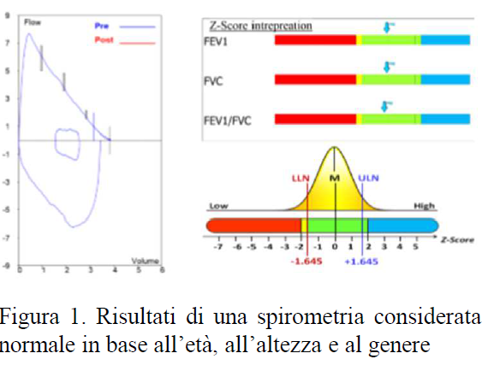
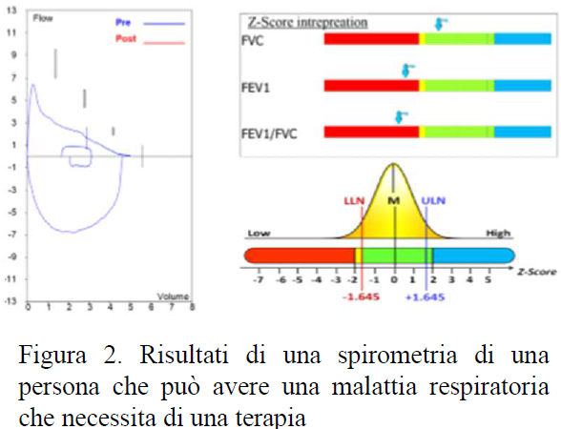
How to interpret the results of Spirometry?
For each person, there is a range of results that is considered normal. For example, if your child’s respiratory function is normal for age, height, and gender, the spirometry will be like the one shown in Figure 1. If your child has a respiratory problem, the spirometry might be like the one shown in Figure 2.
How should I prepare my child for the test?
It is important that your child does not exercise or eat excessively in the 2 hours before this test, as this may affect the result. It is important to check with the doctor in charge of the test whether it is necessary to suspend any inhalation therapies in progress that may affect the result of the test.
In case of normal spirometry, are respiratory problems excluded?
The result within the normal limits of the test as well as the response to the bronchodilator must be carefully evaluated by the doctor. In fact, an asthmatic subject should not be considered "cured" in consideration of a normal spirometric test.
Why should my child repeat this test?
Spirometry is an important indicator of the clinical course of chronic respiratory diseases such as asthma. It may be useful to repeat it to diagnose asthma in subjects who present symptoms, but whose previous spirometry tests have not been useful for confirming the
diagnosis.
Luigi Matera, MD, Dipartimento materno infantile e scienze urologiche, Sapienza Università di Roma
Figure 1. Normal spirometry.
Figure 2. Abnormal spirometry.

